Slide 1
Machine learning physics
Phase transitions

Slide 2
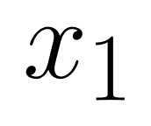

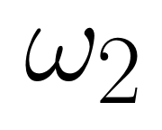
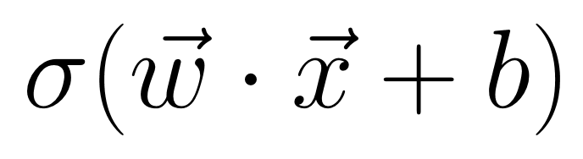
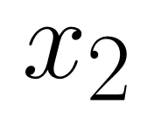

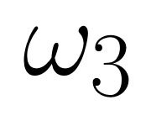
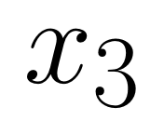
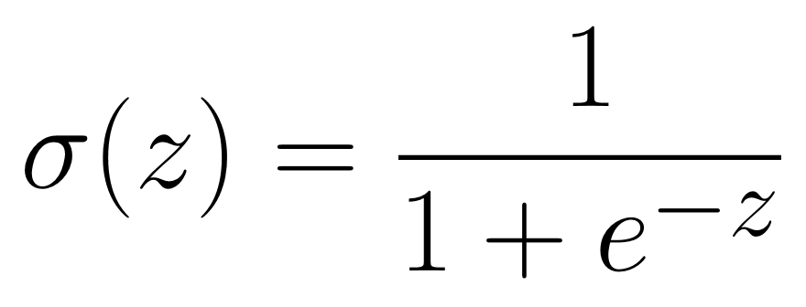
Neural Networks in a nutshell
Typically, the building blocks of a neural network are sigmoid neurons
Logistic activation function

Slide 3
Neural Networks in a nutshell
The network graph defines a concatenation of sigmoid neurons
Input layer
Hidden layer(s)
Output layer

Slide 4
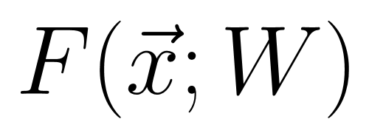
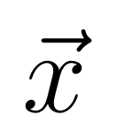
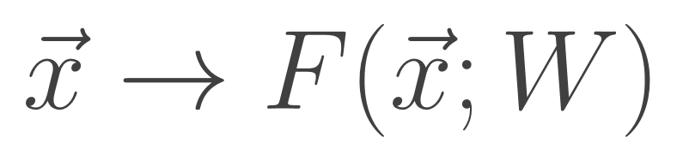
Neural Networks in a nutshell
The network graph defines a concatenation of sigmoid neurons
Neural network is a highly non-linear mapping
Notes:
Highly dimensional input

Slide 5
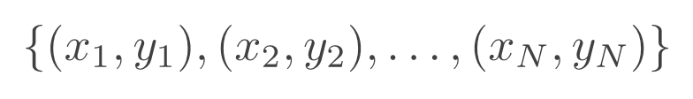
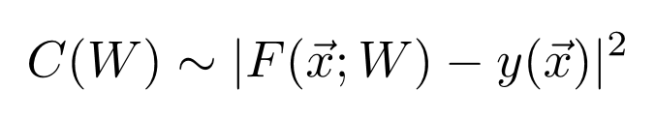
Neural Networks in a nutshell
Labeled training dataset
Cost function measure
Use backpropagation and stochastic gradient descent to adjust weights and biases (check out this great video)
Notes:
Highly dimensional input

Slide 6
Learning phase transitions
Apply image/pattern recognition techniques to physical systems
Carrasquilla, Melko, NPHYS 13 (2017)
Van Nieuwenburg, Liu, Huber, NPHYS 13 (2017)
Broecker, Carrasquilla, Melko, Trebst, arXiv:1608.07848 (2016)
Artificial neural networks have proven to be an extremely powerful tool for feature extraction

Slide 7


Learning phase transitions
Two natural choices for what to take as “image” of the system
Order parameter
Green’s function
imaginary time
space

Slide 8
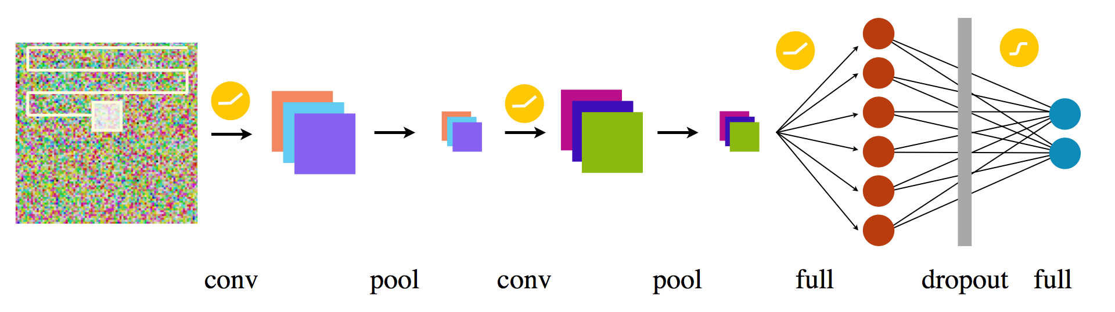
Learning phase transitions
Convolutional neural network (CNN) architecture with preprocessing of input image
Learning smaller recurring features
matrix reductions
conventional

Slide 9
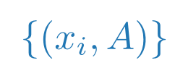
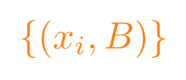

Learning phase transitions
Train network deep in both phases, predict phase in between.
Phase A
Phase B
Train here
$$r_{c}$$
Train here
Point of maximal confusion

Slide 10
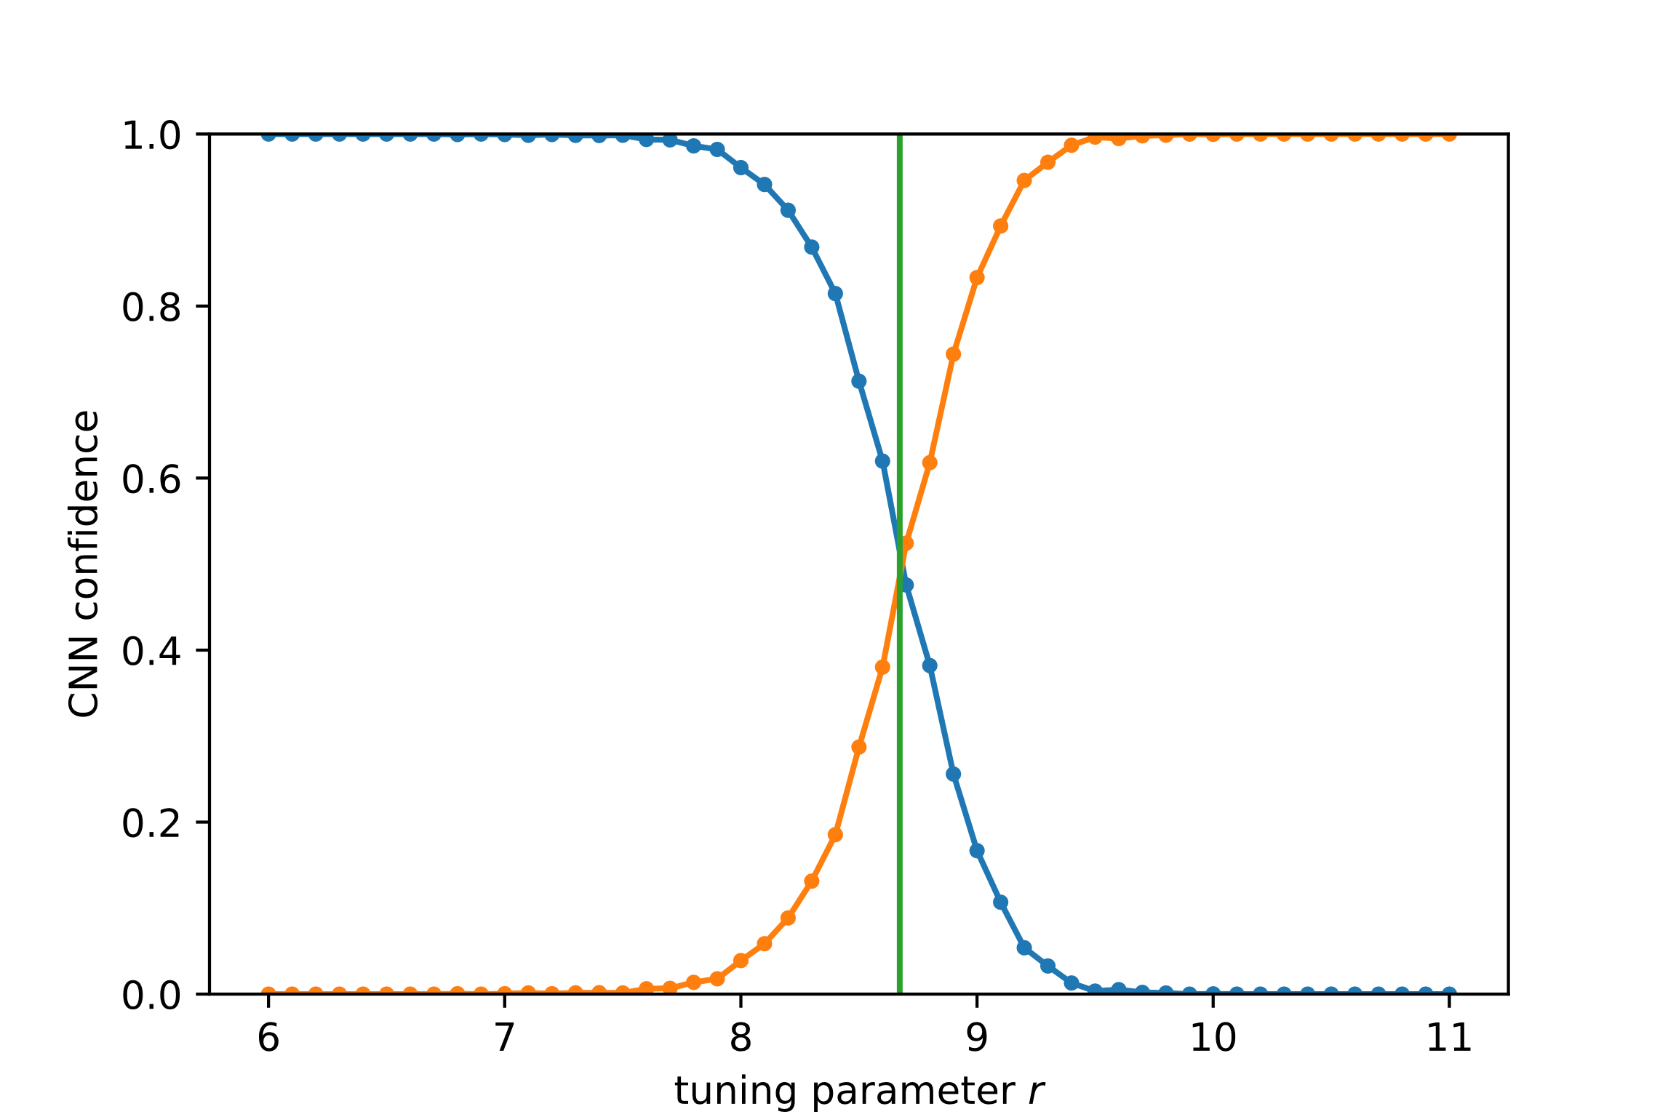

Learning phase transitions
Phase A
Phase B
Train here
$$r_{c}$$
Train here
Phase A
Phase B

